Slide 1
Regression models for count outcomes
蒋智超
2025年 秋

Slide 2
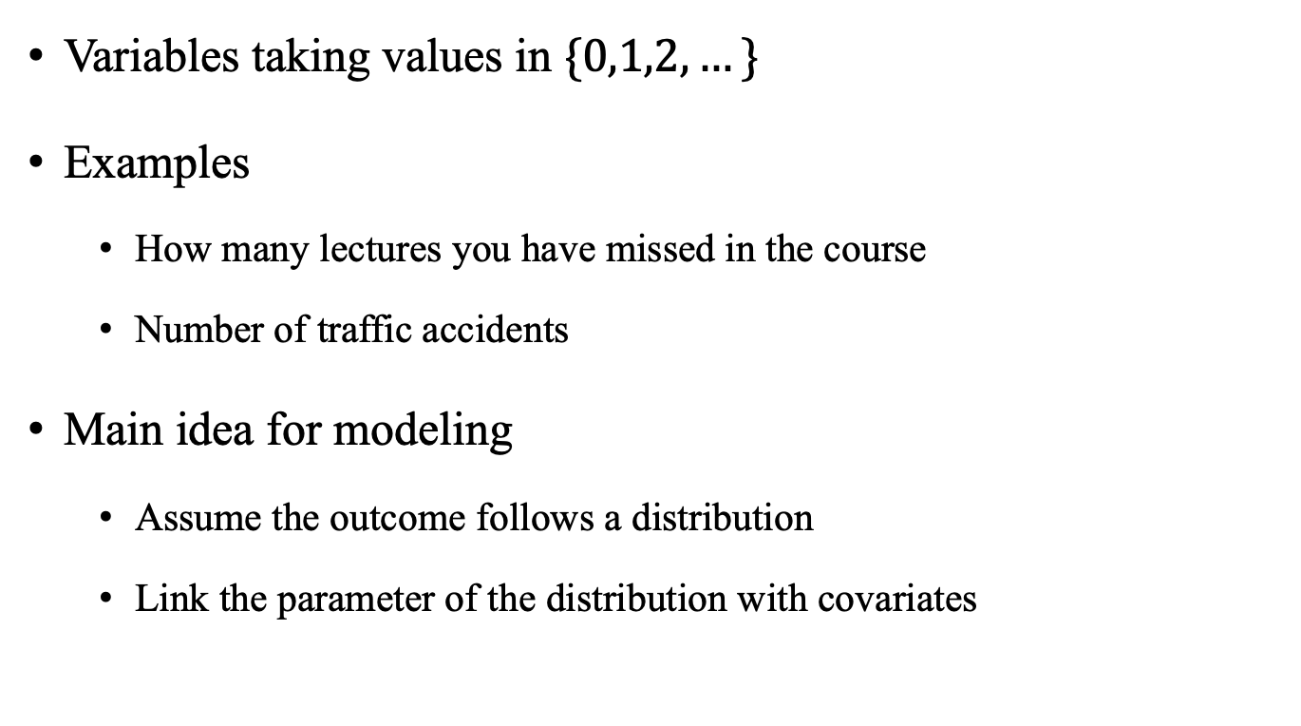
Count outcomes
Variables taking values in $\{0,1,2,…\}$
Examples
How many lectures you have missed in the course
Number of traffic accidents
Main idea for modeling
Assume the outcome follows a distribution
Link the parameter of the distribution with covariates

Slide 3
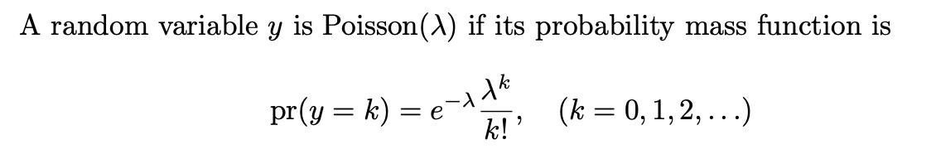
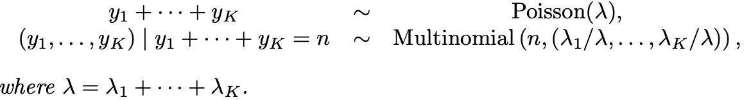

Random variables for count outcomes
Poisson random variable
If $y\sim Poisson(λ)$, then $E\left(y\right)=var\left(y\right)=λ$
If $y_{1},…,y_{K}$ are mutually independent with $y_{k}\sim Poisson(λ_{k})$

Slide 4
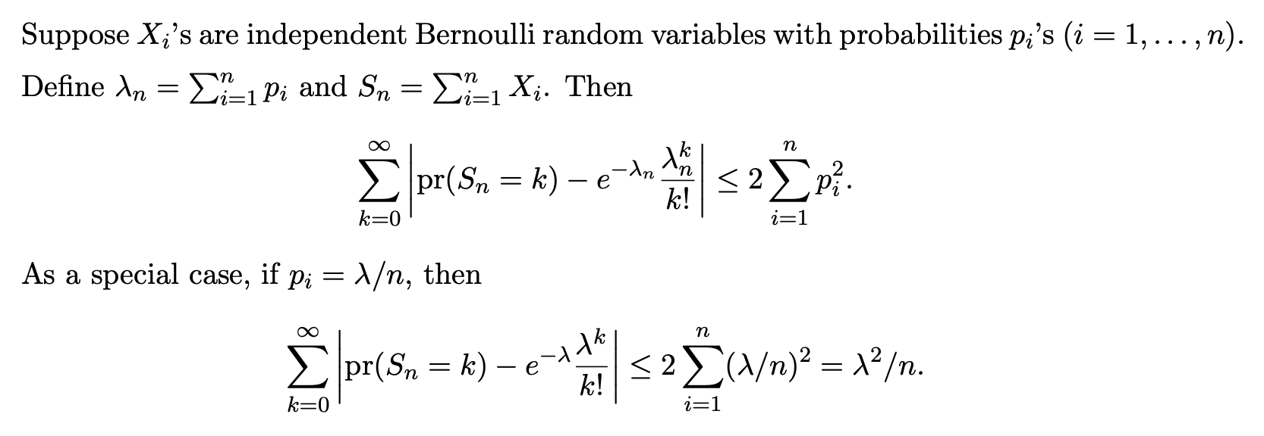

Poisson
If $S\sim Poisson\left(λ\right)$ with $λ=λ_{1}+…+λ_{K}$ and $\left(y_{1},…,y_{K}\right)|S=n \sim Multinomial\left(n,(\frac{λ_{1}}{λ},…\frac{λ_{K}}{λ})\right)$, then $y_{1},…,y_{K}$ are mutually independent with $y_{k}\sim Poisson(λ_{k})$
Law of rare events
Notes:
the sum of IID Bernoulli random variables is approximately Poisson if the probability has order 1/n.
This is called the law of rare events or Poisson limit theorem or Le Cam’s theorem.

Slide 5

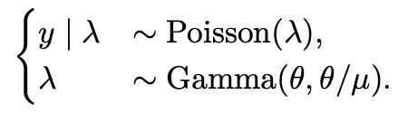
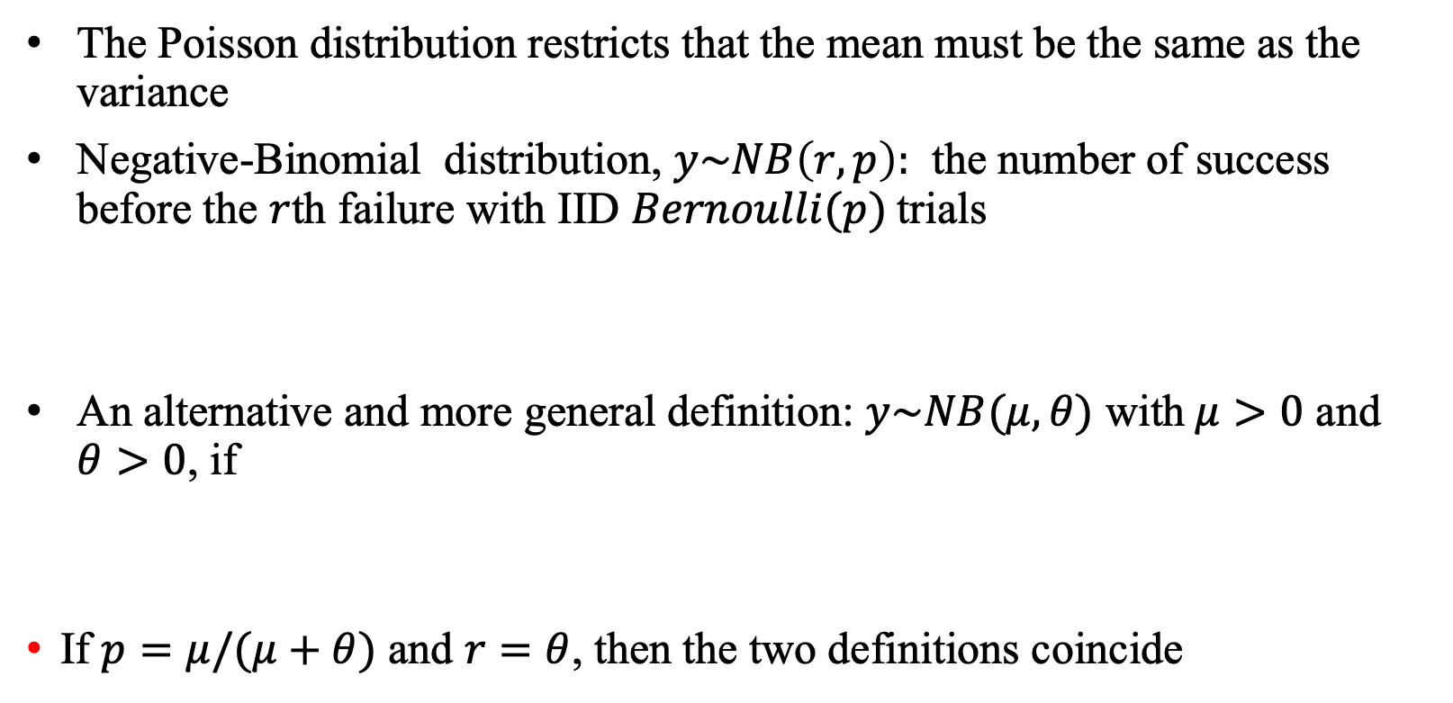
Negative-binomial
The Poisson distribution restricts that the mean must be the same as the variance
Negative-Binomial distribution, $y\sim NB\left(r,p\right):$ the number of success before the $r$th failure with IID $Bernoulli(p)$trials
An alternative and more general definition: $y\sim NB(μ,θ)$ with$μ>0$ and $θ>0$, if
If $p=μ/(μ+θ)$ and $r=θ$, then the two definitions coincide
Notes:
the sum of IID Bernoulli random variables is approximately Poisson if the probability has order 1/n.
This is called the law of rare events or Poisson limit theorem or Le Cam’s theorem.

Slide 6
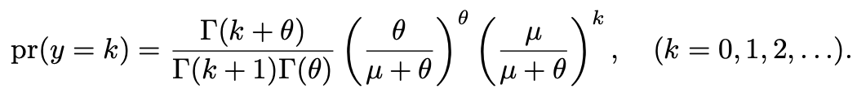
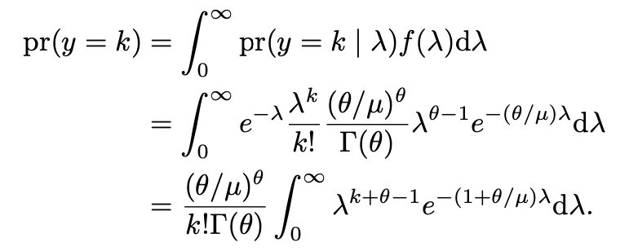
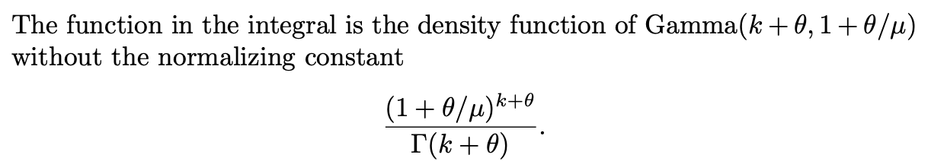
Negative-Binomial
The Negative binomial distribution $y\sim NB(μ,θ)$ has probability mass function
Proof:

Slide 7
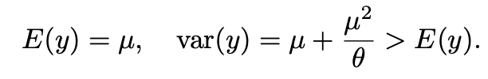

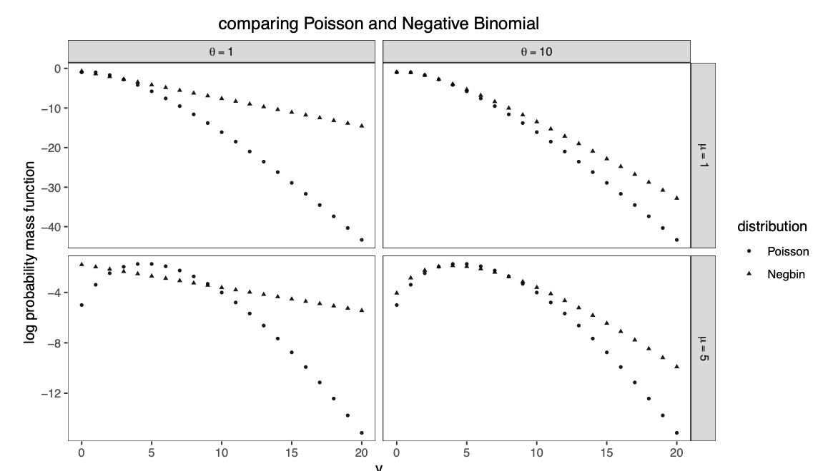
Negative-Binomial
Proof:

Slide 8
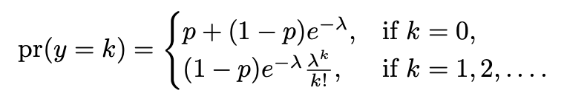
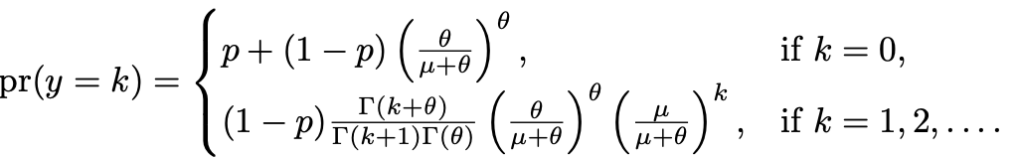
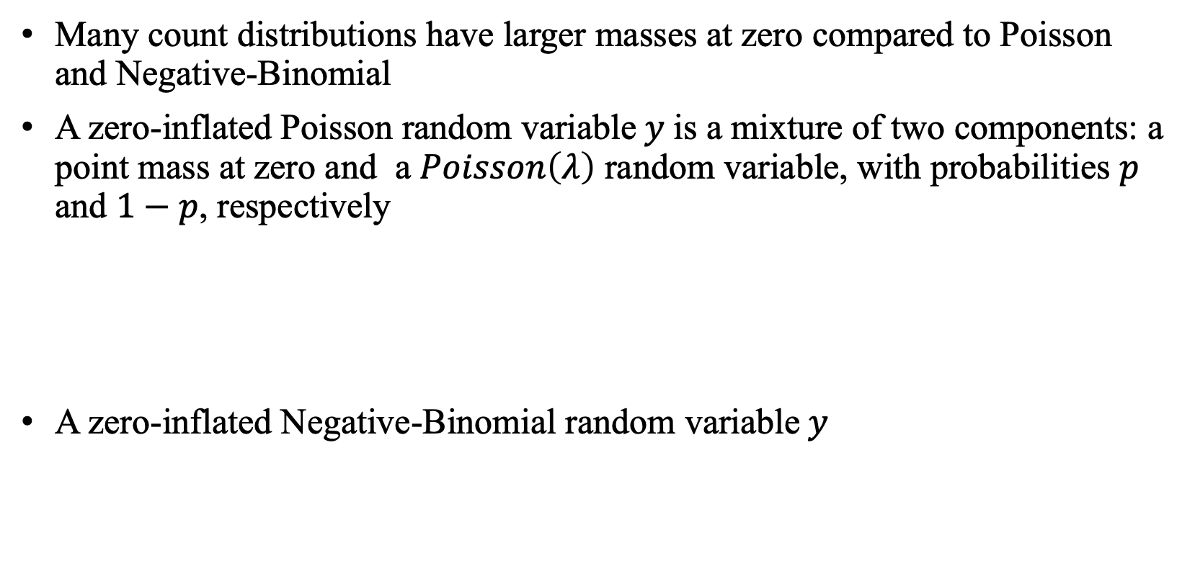
Zero-inflated count distributions
Many count distributions have larger masses at zero compared to Poisson and Negative-Binomial
A zero-inflated Poisson random variable$y$is a mixture of two components: a point mass at zero and a $Poisson\left(λ\right)$ random variable, with probabilities $p$ and $1−p$, respectively
A zero-inflated Negative-Binomial random variable$y$

Slide 9
Regression models for count outcomes
Poisson regression
Negative-binomial regression
Zero-inflated regressions

Slide 10
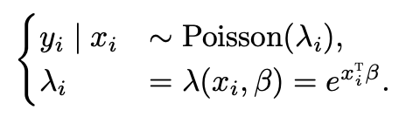


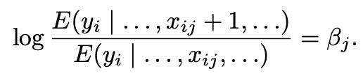
Poisson regression
This model is also called log-linear model
Interpretation: conditional log mean ratio

Slide 11
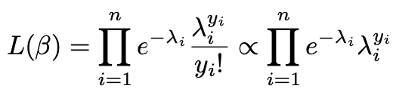
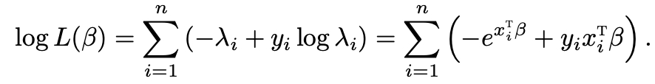
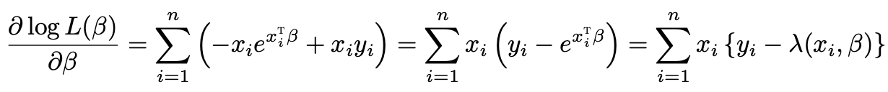
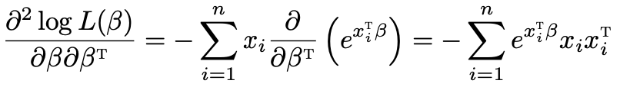
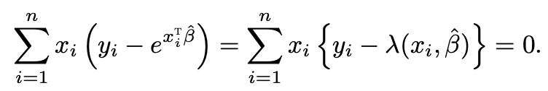
MLE for Poisson regression

Slide 12
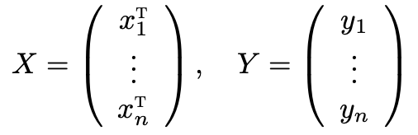
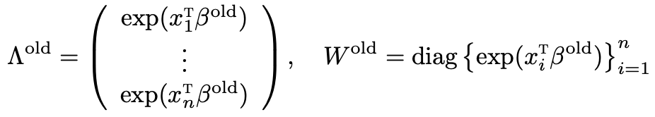
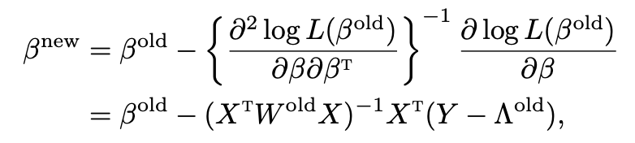


Newton’s method

Slide 13
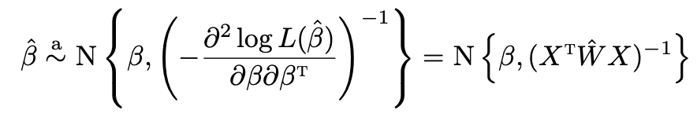



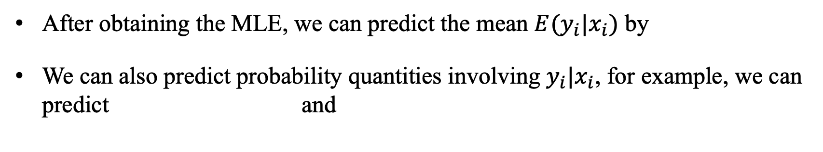
Statistical inference
After obtaining the MLE, we can predict the mean $E(y_{i}|x_{i})$ by
We can also predict probability quantities involving $y_{i}|x_{i}$, for example, we can predict and

Slide 14
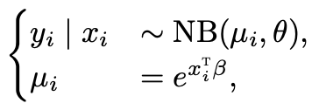

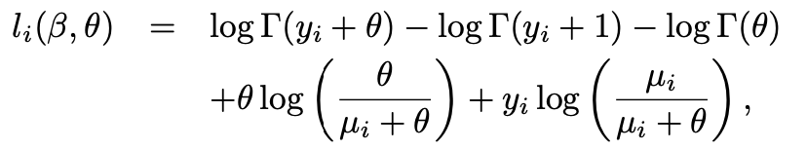
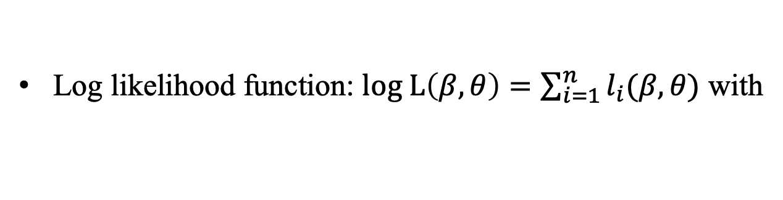
Negative-Binomial regression
Log likelihood function: $log L\left(β,θ\right)=\sum_{i=1}^{n}{l_{i}(β,θ)}$ with

Slide 15
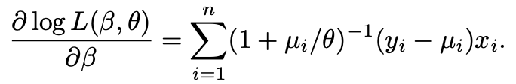
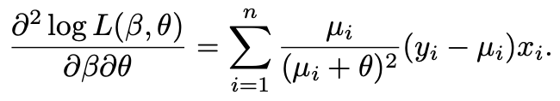
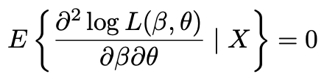
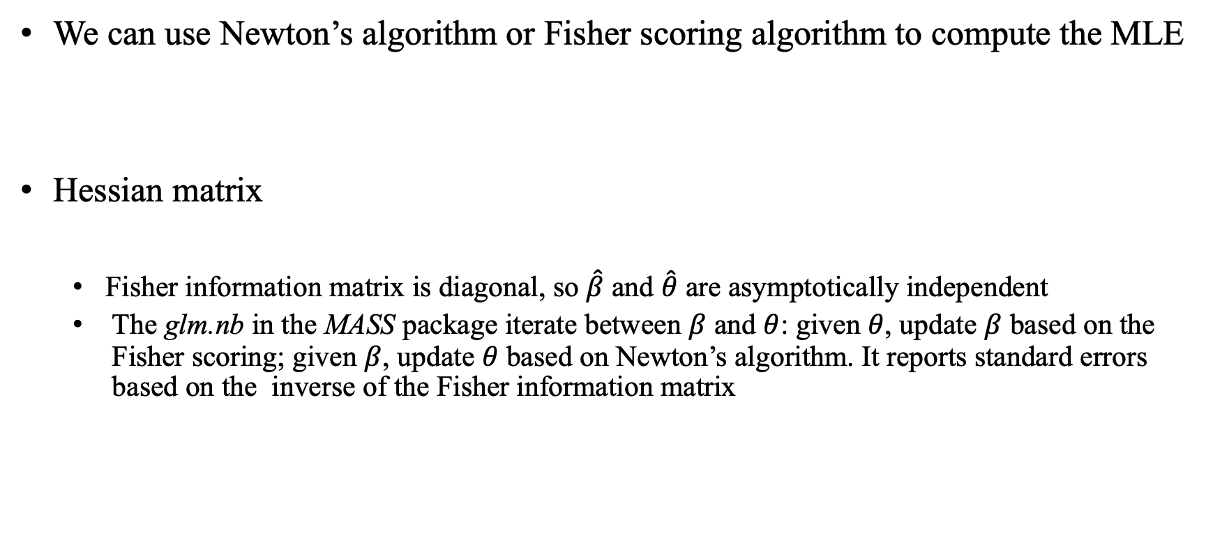
MLE
We can use Newton’s algorithm or Fisher scoring algorithm to compute the MLE
Hessian matrix
Fisher information matrix is diagonal, so $\hat{β}$ and $\hat{θ}$ are asymptotically independent
The glm.nb in the MASS package iterate between $β$ and $θ$: given $θ$, update $β$ based on the Fisher scoring; given $β$, update $θ$ based on Newton’s algorithm. It reports standard errors based on the inverse of the Fisher information matrix

Slide 16
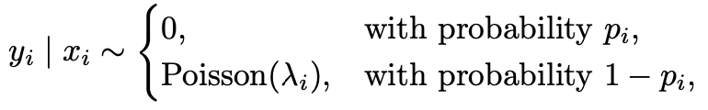
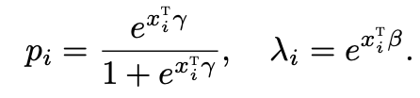
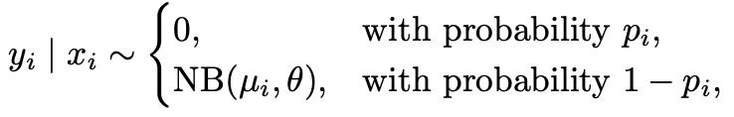

Zero-inflated regressions
Zero-inflated Poisson regression
Zero-inflated Negative-Binomial regression
The zeroinfl function in the pscl package can fit the zero-inflated Poisson and Negative-Binomial regressions

Slide 17
A real data analysis
Dataset from Royer et al. (2015)
Outcome: number of visits to the gym
Treatment: incentive_commit and incentive
Covariates: target and member_gym_pre
Each worker was observed over time, so we run regressions with the data observed in each week
We compute the regression coefficients, standard errors, and AICs

Slide 18
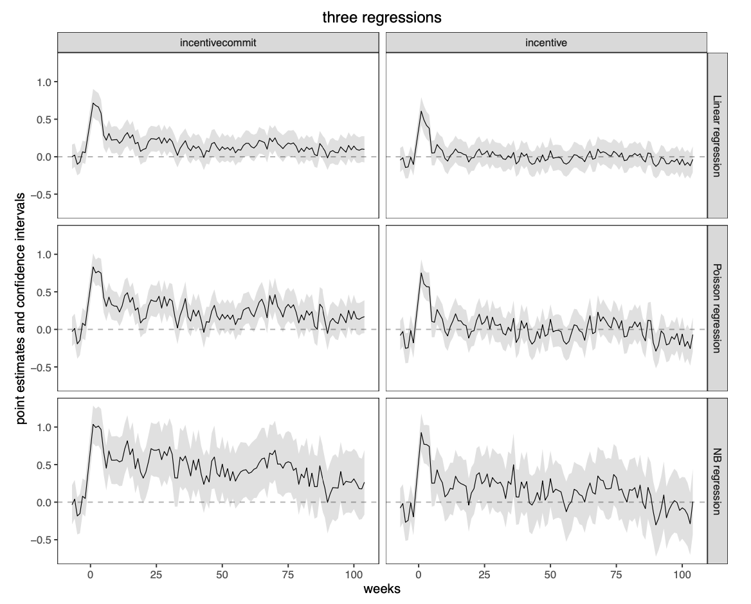
Linear, Poisson, and Negative-Binomial
Notes:
Three regressions give very similar patterns: incentive_commit has both short-term and long-term effects, but incentive only has short-term effect.

Slide 19
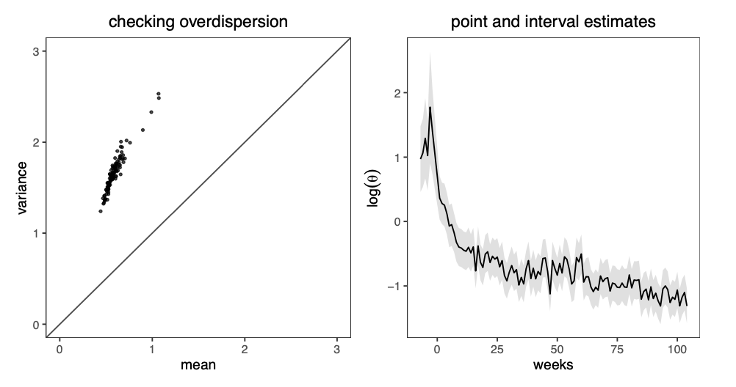
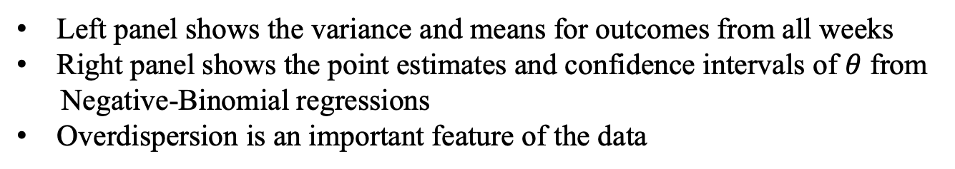
Overdispersion of the data
Left panel shows the variance and means for outcomes from all weeks
Right panel shows the point estimates and confidence intervals of $θ$ from
Negative-Binomial regressions
Overdispersion is an important feature of the data

Slide 20
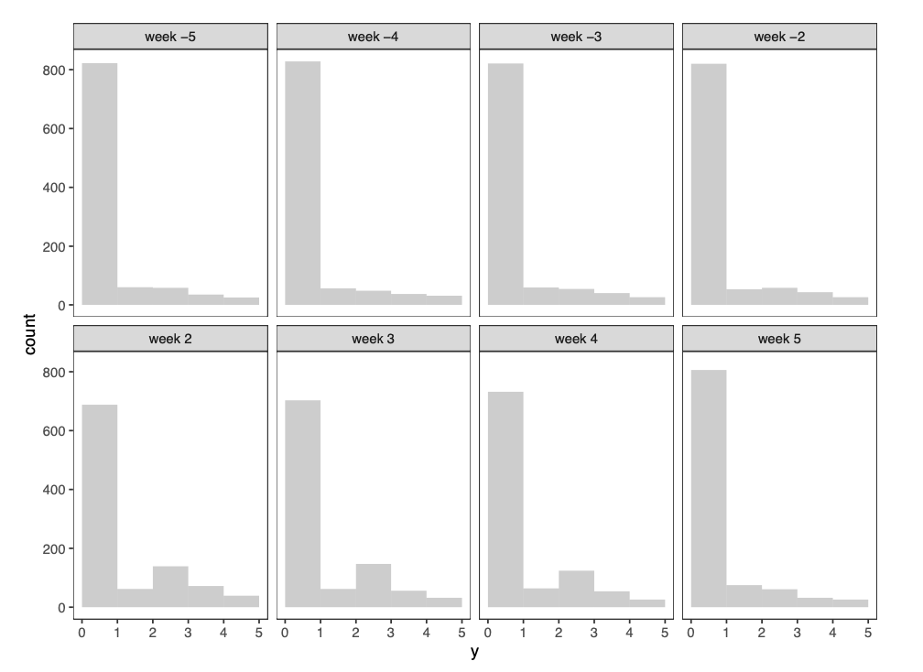
Zero-inflated regressions

Slide 21
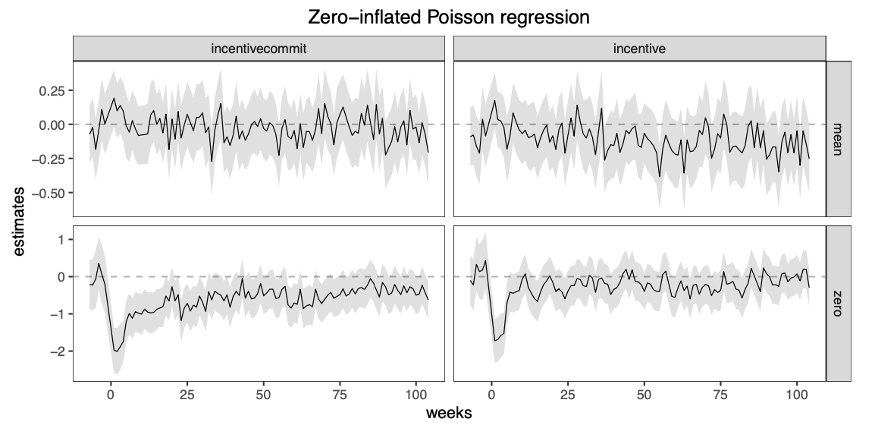
Zero-inflated regressions

Slide 22
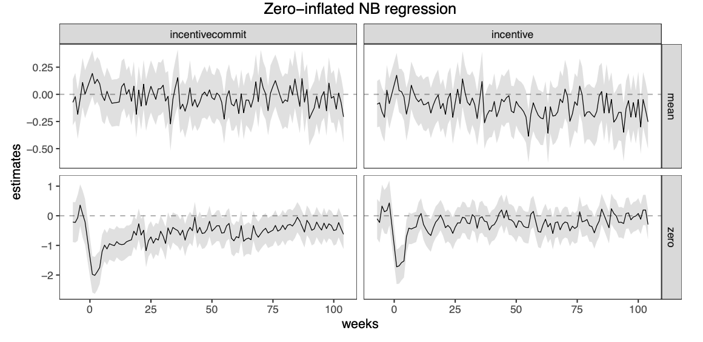
Zero-inflated regressions

Slide 23
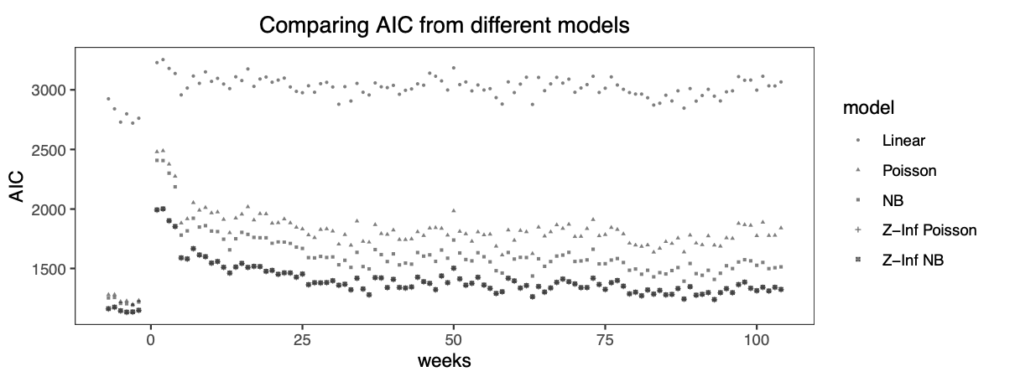
Zero-inflated regressions
$θ$ from the zero-inflated Negative-Binomial regression

